Slide 1
Machine Learning-Based Model to Predict Heart Disease in Early Stage Employing Different Feature Selection Techniques
Techniques
NAME : RIFHA HOSSAIN MUNAJA
ID : 20301466
SECTION : 01

Slide 2
INTRODUCTION
Approximately 26 million people worldwide are affected by heart disease.Annually, 17.9 million people are affected by heart disease contributing to a 32% global death rate.
Diagnosing heart disease is challenging due to the multitude of risk factors with symptoms including physical weakness, chest pain, shortness of breath and irregular heartbeat. Machine learning algorithms are extensively utilized globally especially in the healthcare industry for early disease prediction.Early prediction of diseases by machine learning can significantly reduce the mortality rate from heart disease.
Six machine learning algorithms are evaluated to determine the most accurate for early heart disease prediction seeking to identify the most effective one.

Slide 3
RELATED WORKS
Overview of Heart Disease Prediction Studies Using Machine Learning:
The general trend in using machine learning for heart disease prediction and emphasize the diversity of algorithms and datasets used in these studies.
Algorithms and Their Performances:
Naive Bayes (NB), Random Forest (RF), Decision Trees (DT), Support Vector Machine (SVM), K-Nearest Neighbor (KNN), Artificial Neural Network (ANN) and Linear Regression (LR).Highlight specific accuracy metrics like NB (84.1584% with SVM-RFE), DT and KNN (82.17% and 83.16%, respectively) and ANN (73.3333%).
Feature Selection and Algorithm Efficiency:
The impact of feature selection on the performance of these algorithms.
Mentioned specific feature selection algorithms are mRMR, relief, LASSO.
Comparison of Different Studies and Techniques:
Compare various studies in terms of their approach datasets (like the Cleveland and UCI datasets) and findings.
The variations in performance and the need for comprehensive investigations.

Slide 4
RELATED WORKS
Data Mining and Its Effectiveness:
The use of data mining techniques, particularly in large datasets and studies conducted on patient data and their outcomes.
Limitations and Future Scope:
The limitations of current techniques such as not achieving over 90% accuracy.Suggest improvements like better data handling or using Python for feature selection.
Visual Representation of Heart Disease Analysis Workflow:
The sequential steps involved in predicting heart disease using machine learning.This can be a flowchart or diagram showing the process from data collection to algorithm application and results interpretation.

Slide 5
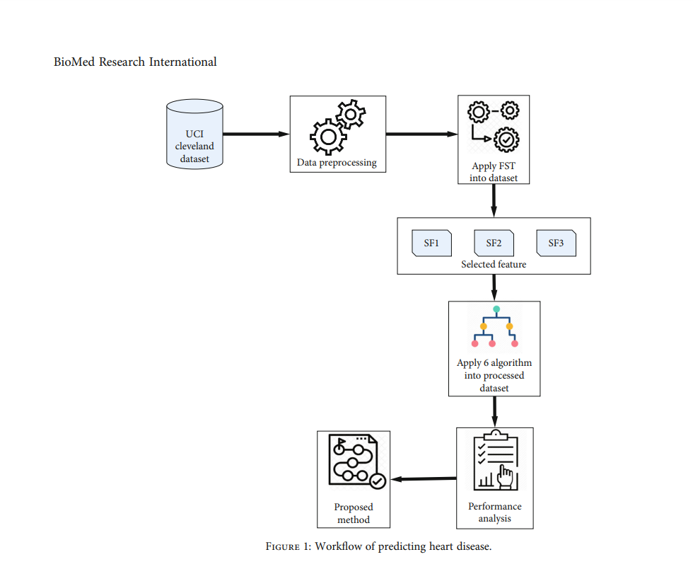
METHODOLOGY

Slide 6
METHODOLOGY
Python 3.8 chosen for its accessibility and ease of rapid algorithm testing. UCI Cleveland Dataset utilized for predicting heart disease.303 patient records with 13 features each.Binary classification: heart patients or normal cases. For Data Pre- processing post-collection, identified and corrected 4 incorrect records on NMV and 2 on TS.Replacement of incorrect values with optimal values.Applied StandardScaler to standardize features (mean 0, variance 1). ANOVA F value used in test to measure similarity and reduce high-dimensional data. Here , these Machine Learning Algorithms Logistic Regression (LR), Support Vector Machine (SVM), k-Nearest Neighbors (KNN), Random Forest (RF), Naive Bayes (NB), Decision Tree (DT). Accuracy is assessed using confusion matrices which are N × N matrices. Sensitivity measures the proportion of true positive cases relative to all actual positive cases. Specificity calculates the proportion of true negative cases relative to all actual negative cases.Area Under the Receiver Operating Characteristic (AUROC) assesses the performance of a classification model using True Positive. Log Loss is a classification loss function used to evaluate the performance of machine learning algorithms.

Slide 7
Experimental Setting
Jupyter Notebook used for heart disease prediction analysis.Utilized Pandas 1.1 and NumPy 1.19.0 libraries in Python for cleaning the UCI HD dataset.The dataset was reprocessed using the StandardScaler algorithm from Scikit-learn library.
Applied feature selection algorithms to determine feature importance.Created three different selected feature (SF) sets. The dataset into training and testing sets used 70% of the data as a training set and the remaining as a test set. Trained six different machine learning algorithms using the 70% test data.
Evaluated algorithm performance to select the one with the highest accuracy.The algorithms used for training (LR, SVM,KNN, RF, NB, DT).

Slide 8
RESULT DISCUSSION
C4 achieved the highest accuracy (94.51%) for SF3.C1 had the second-highest accuracy (93.41%) across all SFs.C4 showed the highest sensitivity (94.87%) and specificity (94.23%) for SF3. C1 led in AUROC (96.08%) for SF3 and had the lowest log loss (0.27%) for SF2 and SF3.
C4 identified as the best predictive model based on accuracy, sensitivity, and specificity for SF3. C1 considered the second-best predictive model overall for AUROC and log loss for SF2 and SF3.
SVM demonstrated the best performance for accuracy, sensitivity, and specificity.LR exhibited the best performance for AUROC and log loss. Compared the results with other studies, showcasing higher accuracy (above 90%) for most machine learning algorithms.

Slide 9
CONCLUSION
In this study, main focus was on enhancing the predictive capabilities of heart disease detection through the implementation of various feature selection techniques and the application of six distinct machine learning algorithms. The research involved the identification of highly significant features crucial for accurate prediction. Among the algorithms, SVM and LR emerged as particularly best performers. However, it's important to note that the dataset used for this analysis was relatively limited in size impacting the potential of the predictive model. To achieve a more robust and reliable outcome future experiments are planned intending to leverage larger real-world patient datasets. Furthermore, the exploration of more advanced algorithms, including deep learning is on the agenda along with an emphasis on refining feature selection techniques. The ultimate goal is to continually enhance the accuracy and efficiency of algorithms in the critical domain of heart disease prediction.

Slide 10
THANK YOU

